Slide 1
Histogram Processing

Slide 2
What is a Histogram?
In Statistics, Histogram is a graphical representation showing a visual impression of the distribution of data.
An Image Histogram is a type of histogram that acts as a graphical representation of the lightness/color distribution in a digital image. It plots the number of pixels for each value.

Slide 3
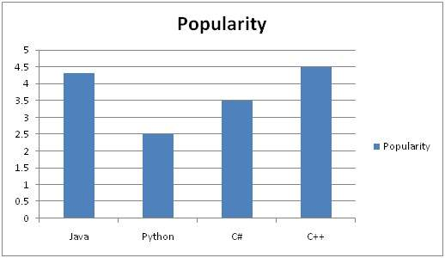
What is a Histogram?
A histogram is a graph. A graph that shows frequency of anything. Usually histogram have bars that represent frequency of occurring of data in the whole data set.

Slide 4
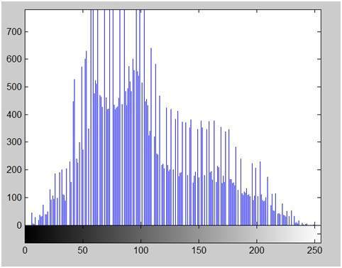
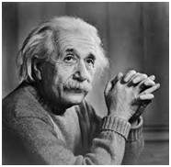
Histogram of an image
Histogram of an image, like other histograms also shows frequency. But an image histogram, shows frequency of pixels intensity values. In an image histogram, the x axis shows the gray level intensities and the y axis shows the frequency of these intensities.

Slide 5
Applications of Histograms
For analysis of an image
To adjust brightness/contrast of an image
To equalize an image
Histograms can be used in thresholding

Slide 6
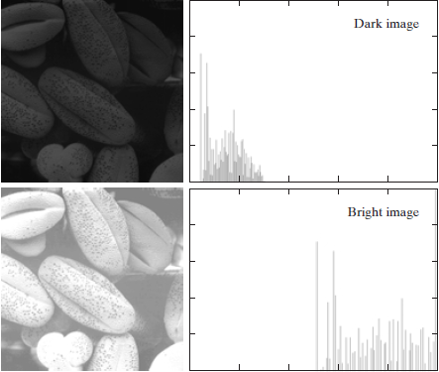
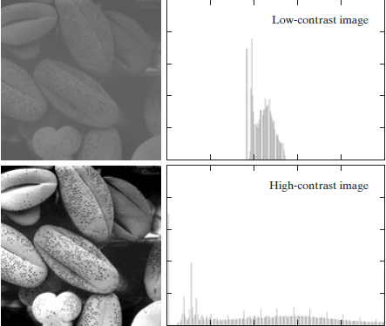
Example of Histograms

Slide 7
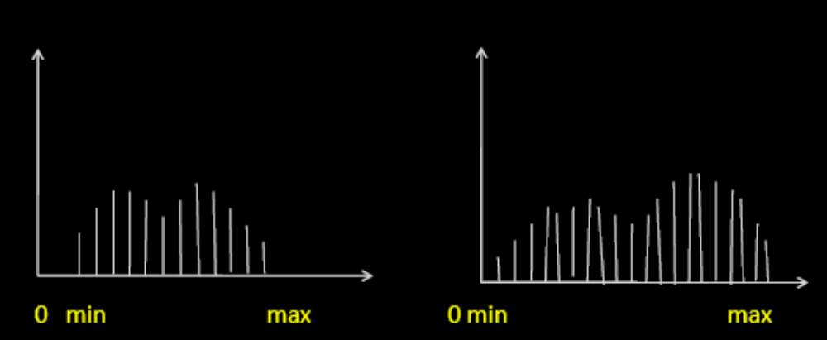
Linear Stretching of Histogram
Linear stretching is used to increase the dynamic range.
The basic shape of the histogram remains the same.

Slide 8
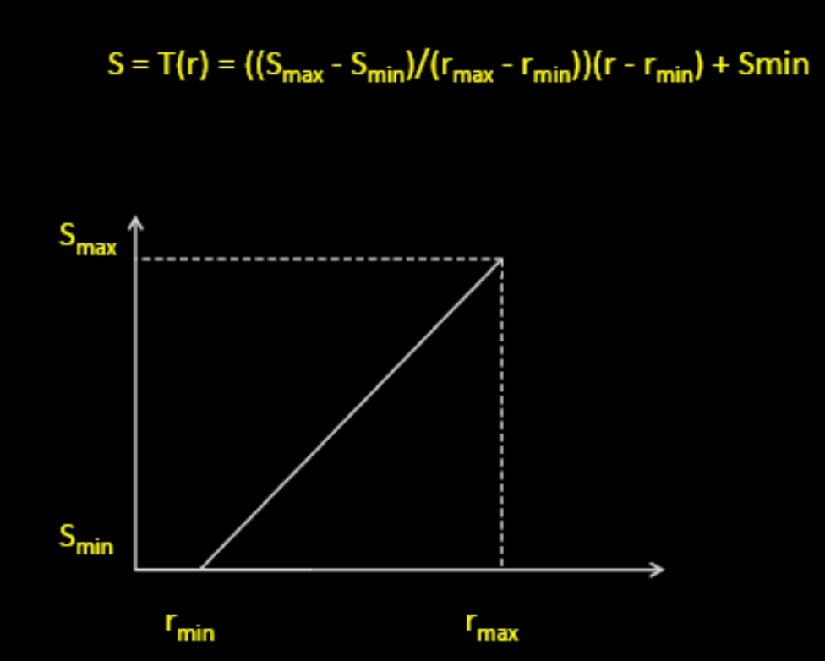
Histogram Processing
Where, S_{max} → Max. gray level of output image,
S_{min} → Min. gray level of output image
r_{max} → Max. gray level of input image
r_{min} → Min. gray lebvel of input image

Slide 9
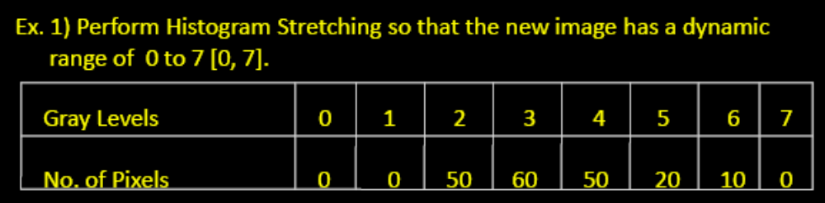
Problem 1

Slide 10
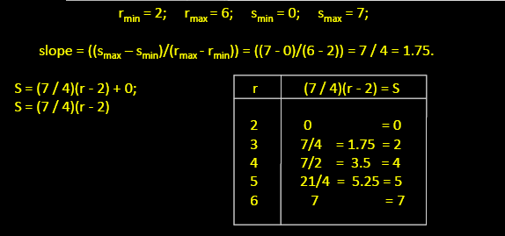
Solution 1

Slide 11

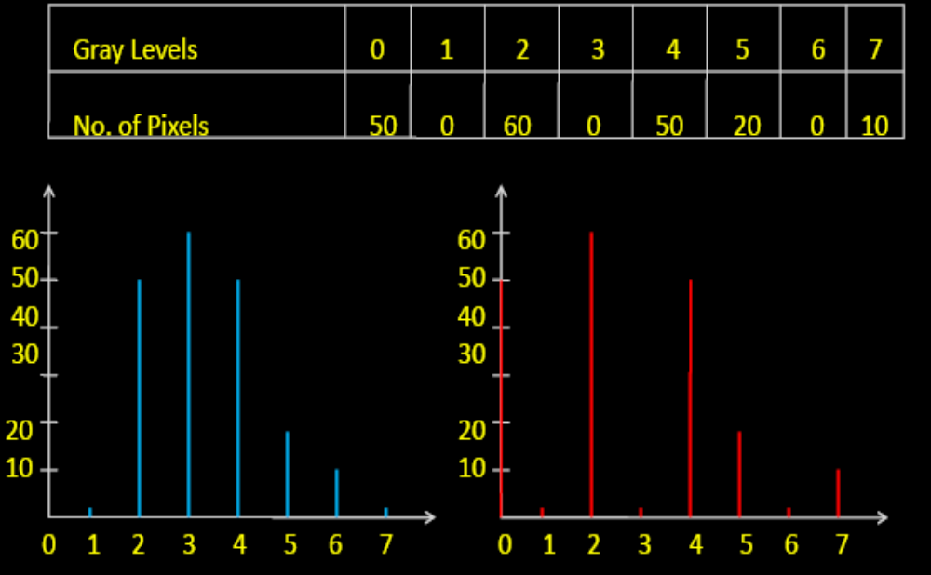
Solution 1

Slide 12
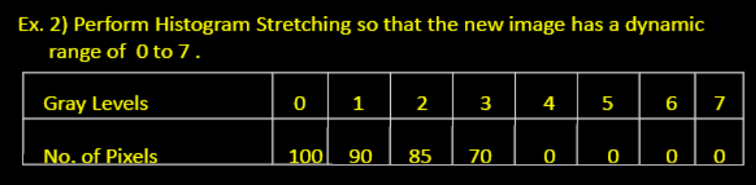
Problem 2

Slide 13
Solution 2
r_{min} = 0 ; r_{max} = 3
S_{min} = 0; S_{max} = 7
S = ((S_{max} – S_{min})/(r_{max} – r_{min}))*(r – r_{min} ) + S_{min}
_{S = (7/3)*(r - 0) + 0}

Slide 14
Solution 2
r_{min} = 0 ; r_{max} = 3
S_{min} = 0; S_{max} = 7
S = ((S_{max} – S_{min})/(r_{max} – r_{min}))*(r – r_{min} ) + S_{min}
_{S = (7/3)*(r - 0) + 0}
r = 0; S = 0
r = 1; S = 7/3 = 2.3 =>2
r = 2; S = 7/3 * 2 = 4.5 =>5
r = 3; S = 7/3 *3 = 7

Slide 15
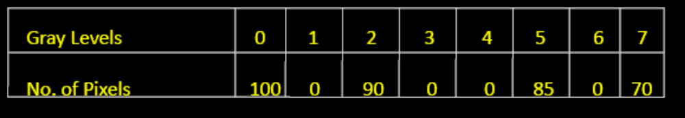
r = 0; S = 0
r = 1; S = 7/3 = 2.3 =>2
r = 2; S = 7/3 * 2 = 4.5 =>5
r = 3; S = 7/3 *3 = 7

Slide 16
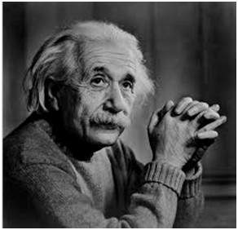

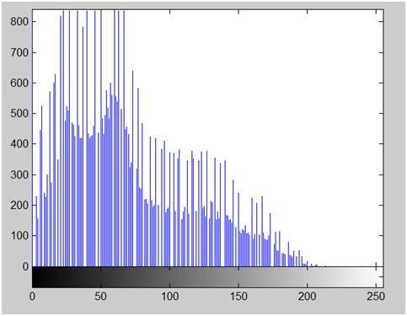
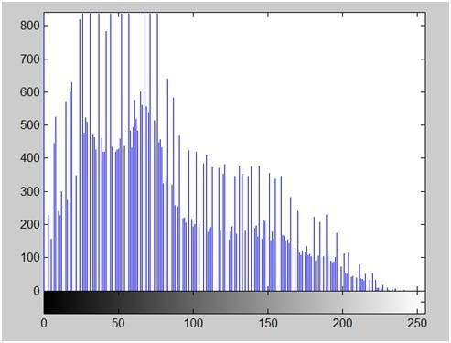

Slide 17
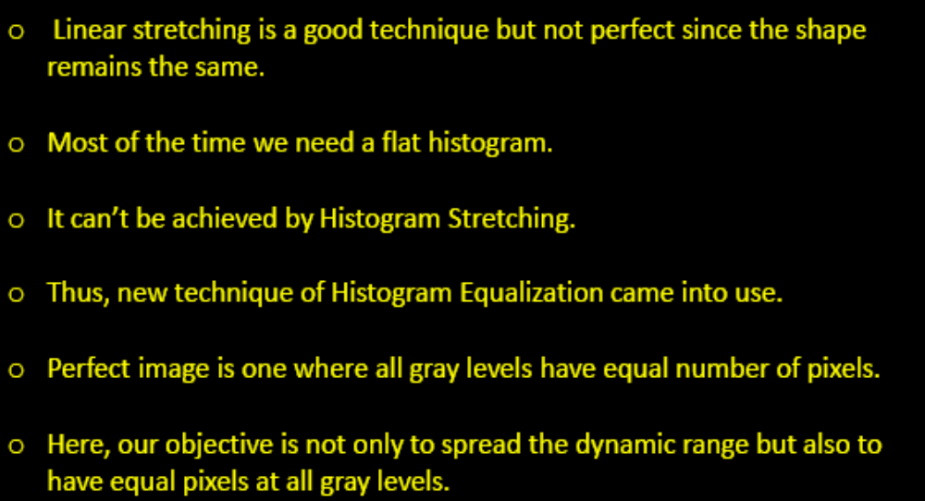
Histogram Equalization

Slide 18
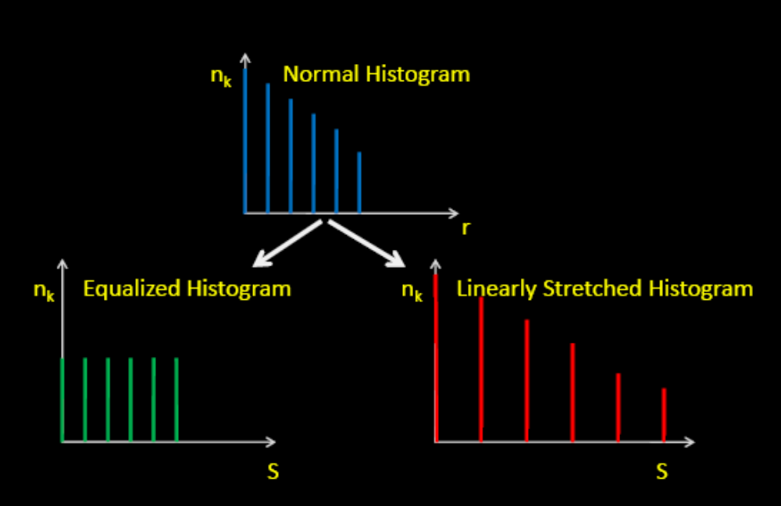
Histogram Equalization

Slide 19
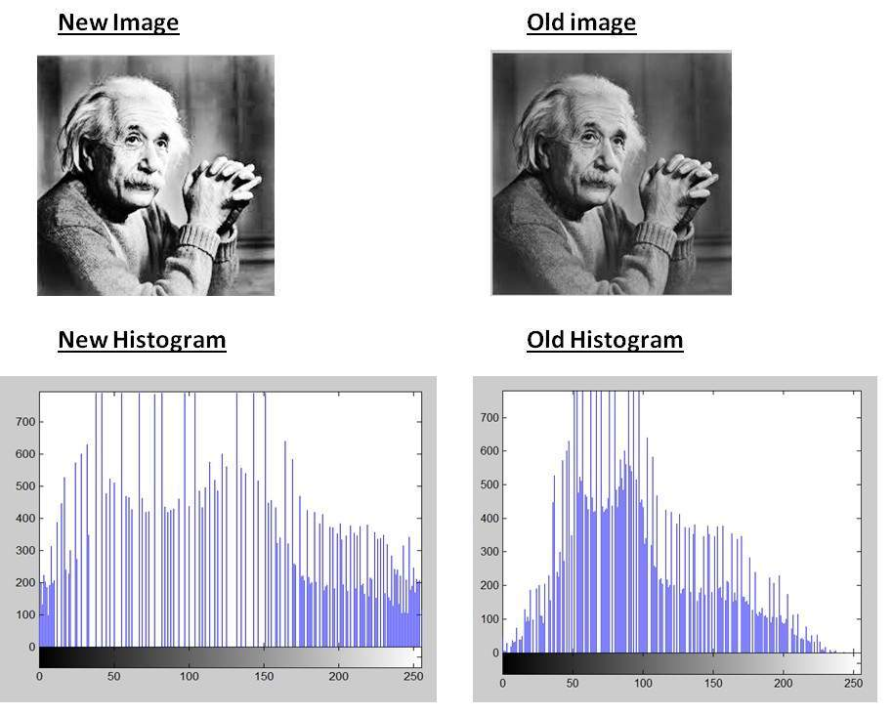
Histogram Equalization

Slide 20
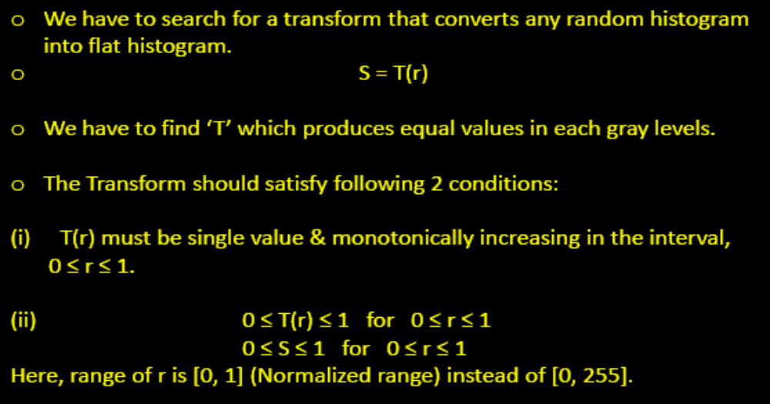
Histogram Equalization

Slide 21
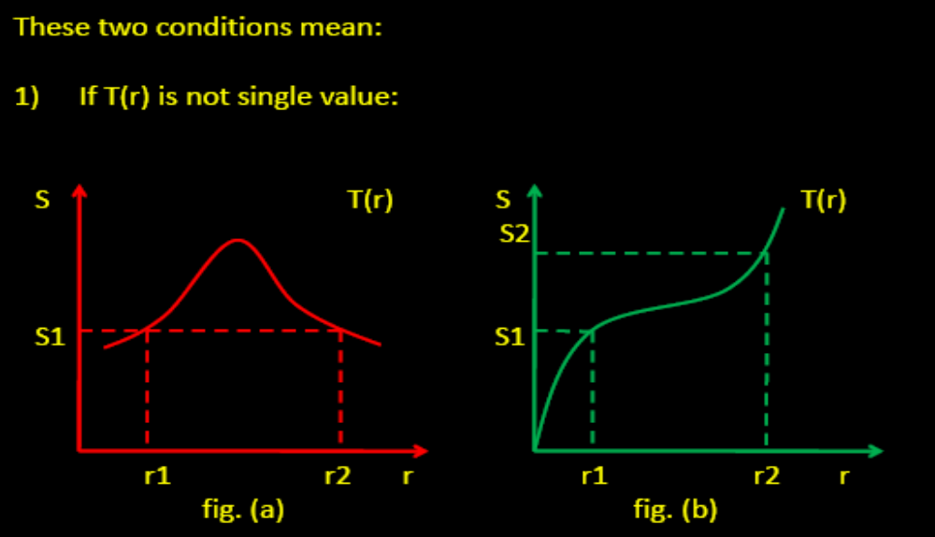
Histogram Equalization

Slide 22
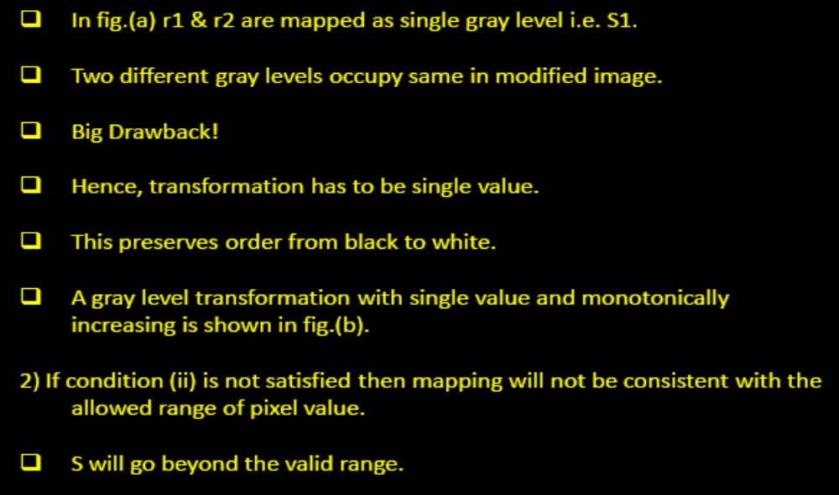
Histogram Equalization

Slide 23
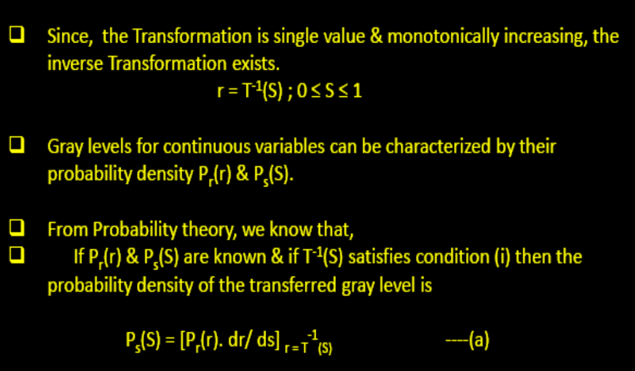
Histogram Equalization

Slide 24
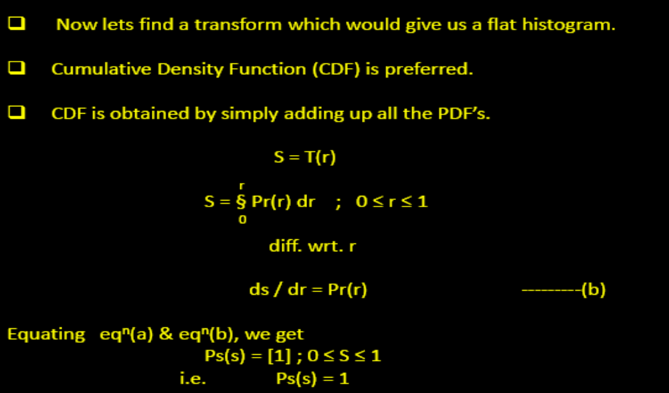
Histogram Equalization

Slide 25
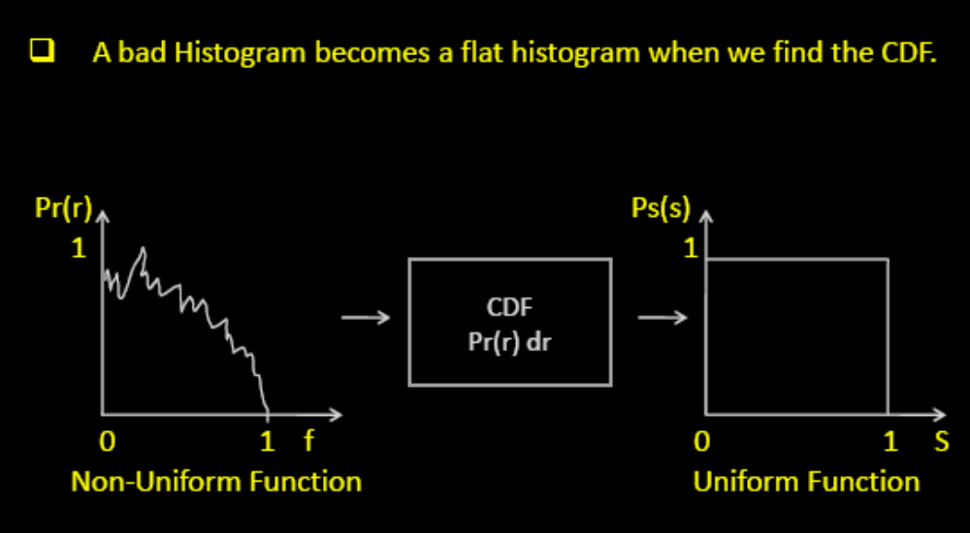
Histogram Equalization

Slide 26
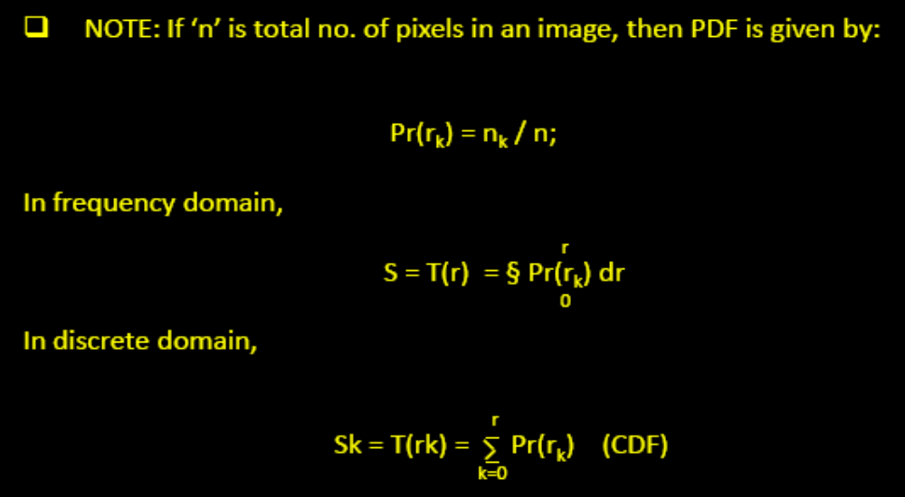
Histogram Equalization

Slide 27
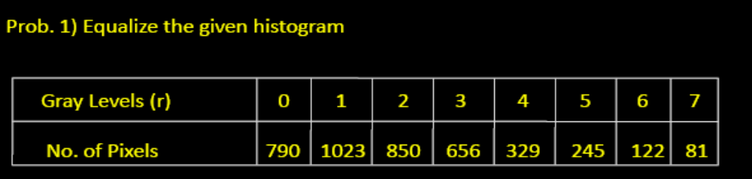
Problem 1

Slide 28
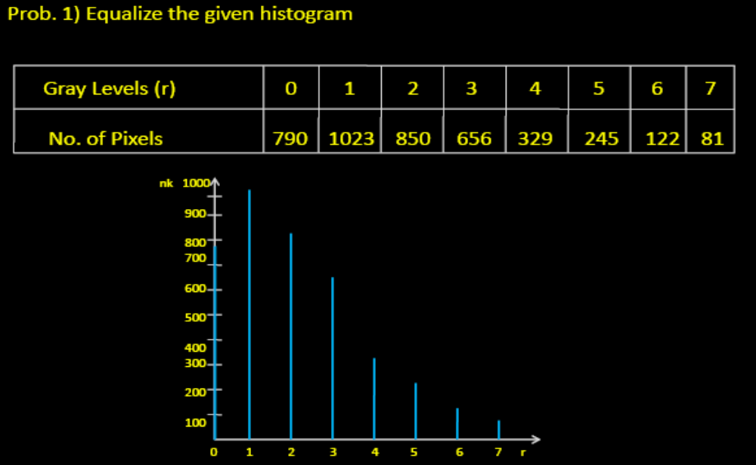
Solution 1

Slide 29
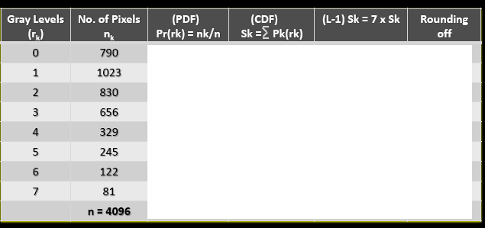
Solution 1

Slide 30
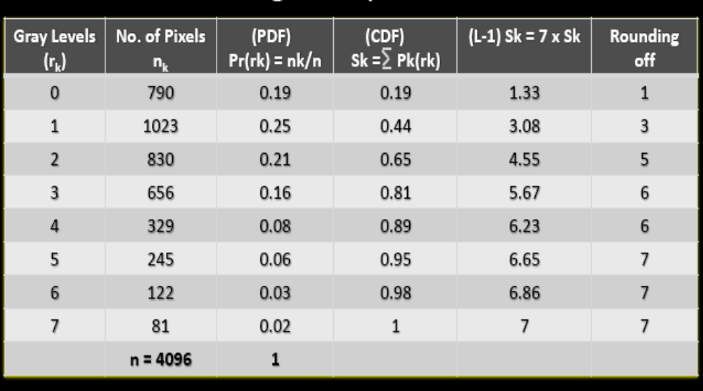
Solution 1

Slide 31
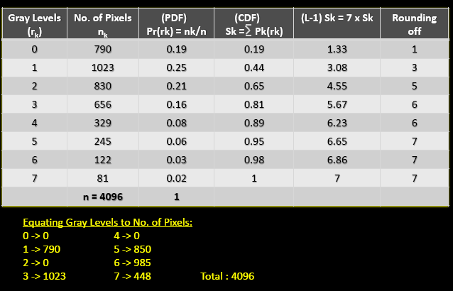
Solution 1

Slide 32
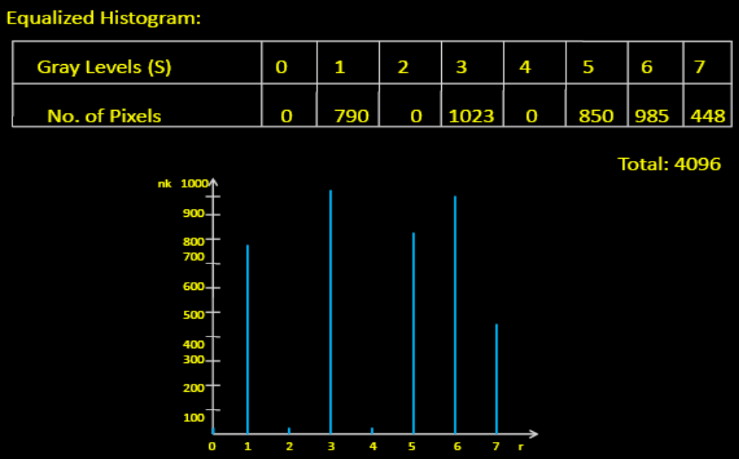
Solution 1

Slide 33
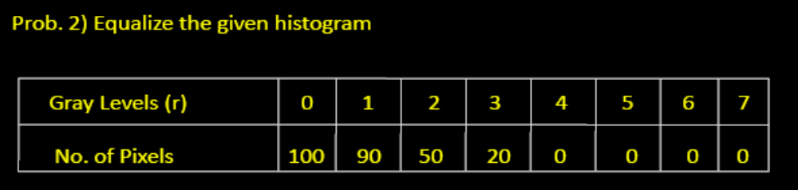
Problem 2

Slide 34
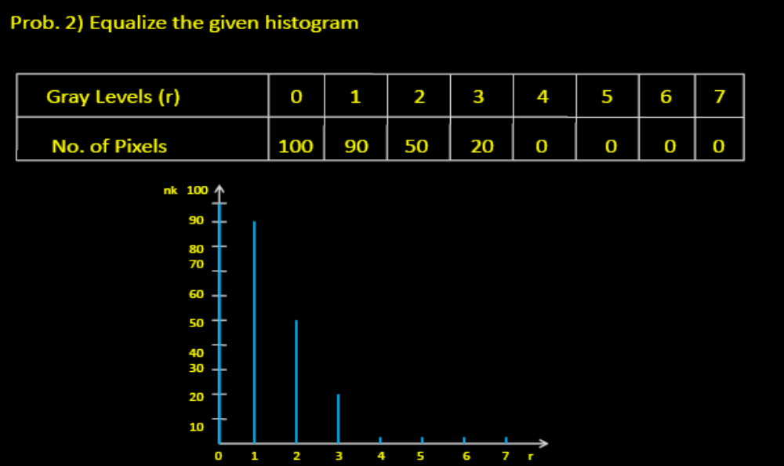
Solution 2

Slide 35
Problem 3
Re-equalize the Solution 1

Slide 36
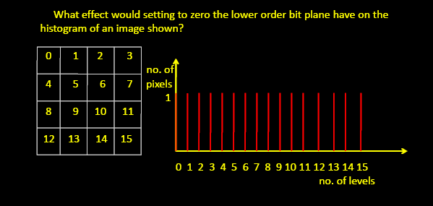
Work to do - 1

Slide 37
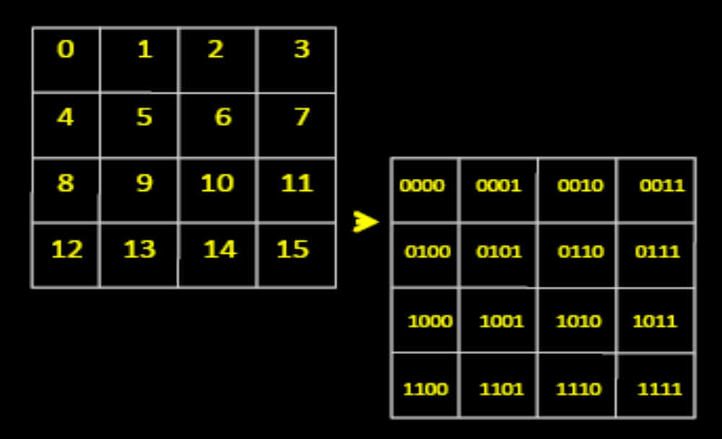
Work to do - 1

Slide 38
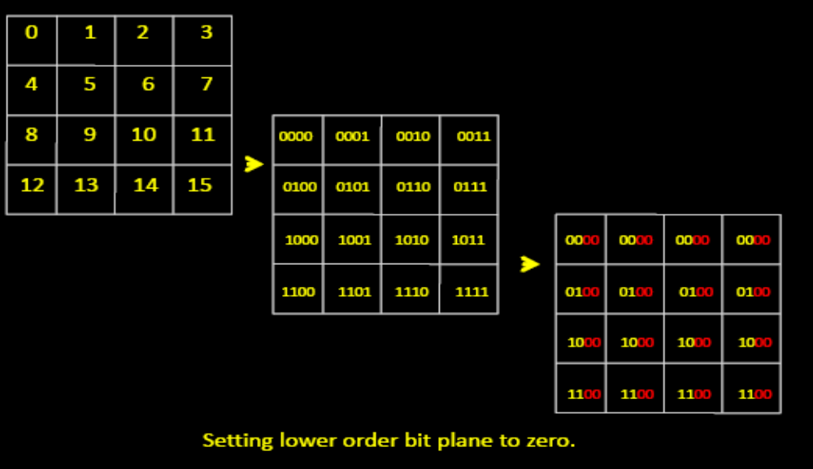
Work to do - 1

Slide 39
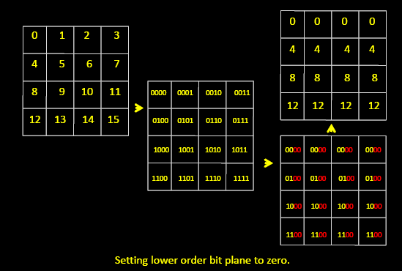
Work to do - 1

Slide 40
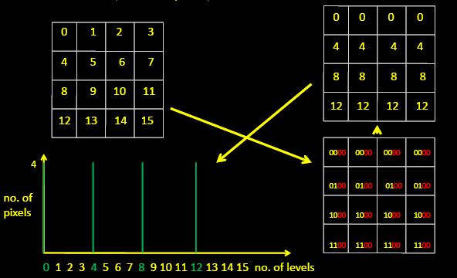
Work to do - 1

Slide 41
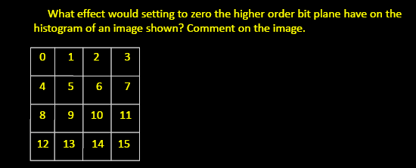
Work to do - 2

Slide 42
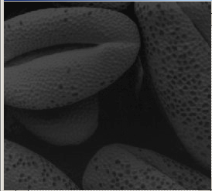
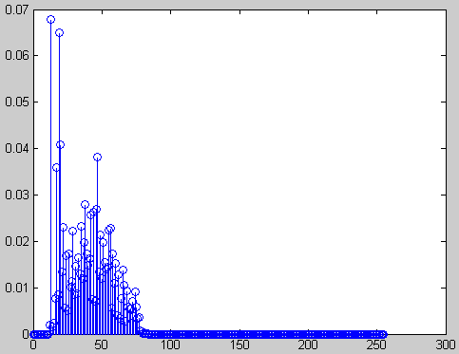
Example
Original image and its histogram

Slide 43
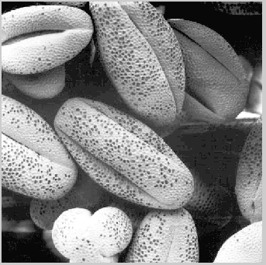
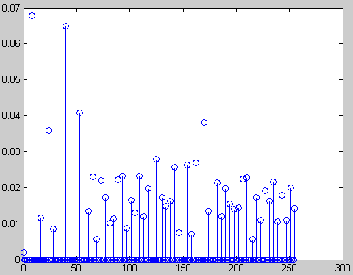
Histogram equalized image and its histogram

Slide 44
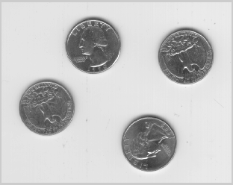
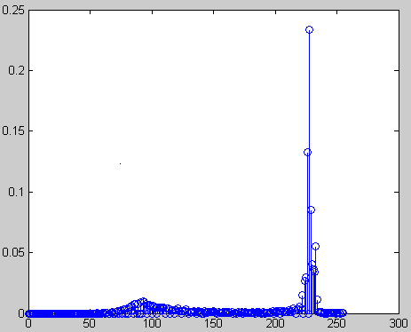
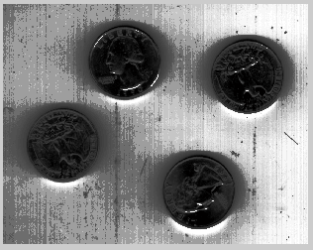
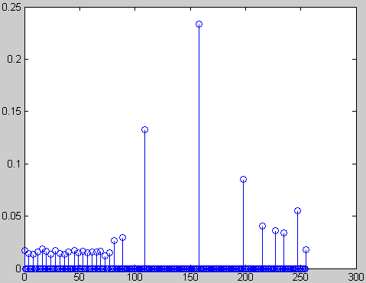
• Comments:
Histogram equalization may not always produce desirable
results, particularly if the given histogram is very narrow. It
can produce false edges and regions. It can also increase
image “graininess” and “patchiness.”

